Slide 1
Block Pulse Data Engineering Project
Miriam Ali
July 2025

Slide 2
Agenda
Introduction
Architecture Diagram
Data Wearehouse Modeling (Star Schema)
Technology and Tools

Slide 3
Introduction
The crypto market changes rapidly our teams need daily, reliable, and historical insight into price, volume, and market trends. Existing APIs like CoinGecko only provide real-time snapshots, not usable trend data. We needed a solution that enables:
  Time-series analysis
  Performance monitoring
  Business intelligence dashboards
  Future advanced analytics like volatility and forecasting

Slide 4
My Role as a Data Engineer
As the lead Data Engineer for BlockPulse, I was responsible for building end-to-end data pipelines that are:
  Automated: Runs daily without manual input
  Scalable: Handles growth in asset coverage and data volume
  Reliable: Includes monitoring, fault tolerance, and error logging

Slide 5
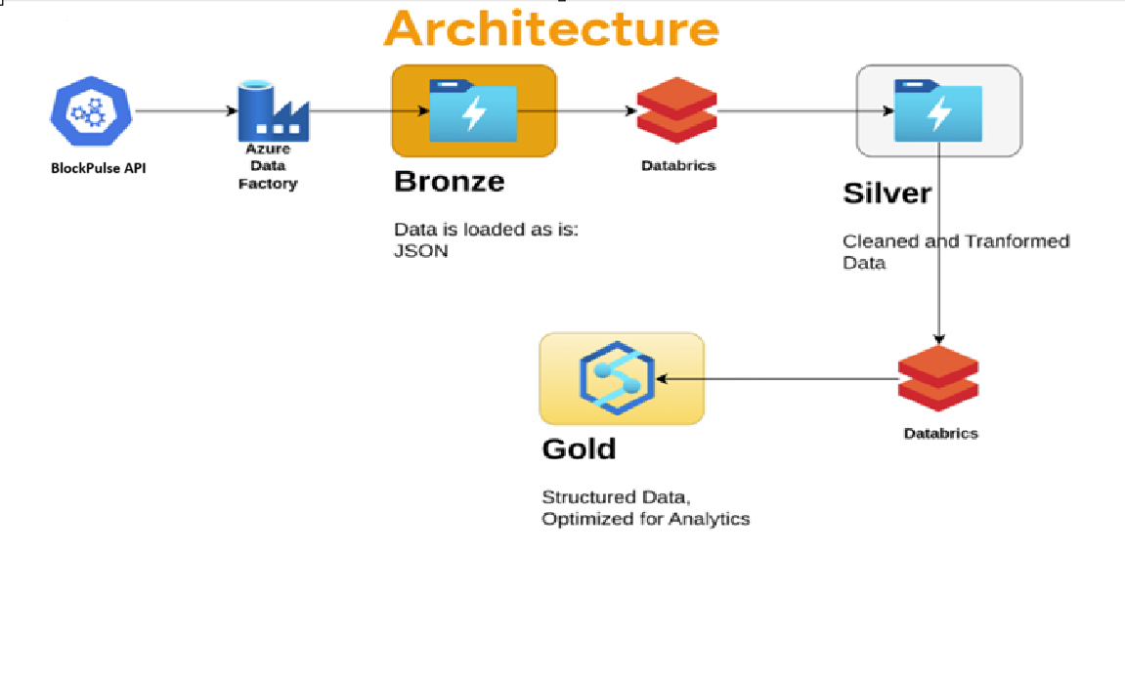
Architecture Diagram of pipeline

Slide 6
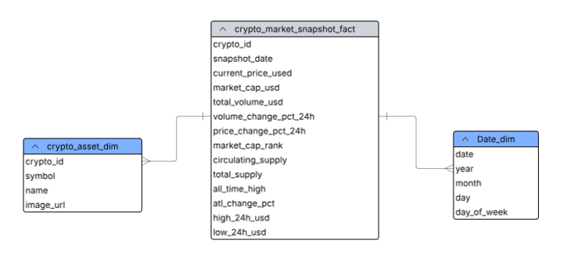
BlockPulse Data warehouse modelling image

Slide 7
Technology and Tools
  Cloud Provider: Azure
  Azure Databricks: Pipeline orchestration, Delta Lake processing
  Azure Data Lake Gen 2: Storage with versioned, partitioned tables
  Azure Synapse: Query and dashboard endpoint
  Azure Data Factory

Slide 8
Future Roadmap
Incorporate more CoinGeiko endpoints
Add derived metrics like 7-day Volatility, Moving averages
Enable Realtime streaming for shorter time priods

Slide 9
Thank you
Miriam Ali
Data Engineer
10Alytics

